Slide 1


CUSTOMERS AND RENTAL INSIGHTS
VISUAL REPORT

Slide 2
THE FOLLOWING PRESENTATION IS A VISUAL REPORT FOR OUR BUSINESS MANAGERS AT ROCKBUSTER thar portrays the most important finding related to rental rate numbers, rental duration. Also, it shows the countries where rockbuster has the highest number of customers. Rockbuster marketing team is interested in launching a rewards campaign for the most loyal customers. These are our finding.

Slide 3
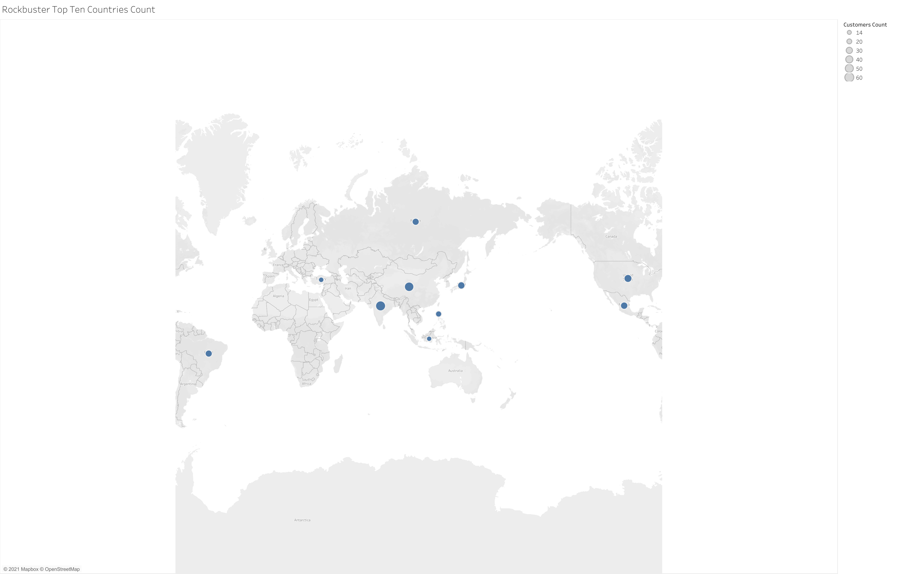
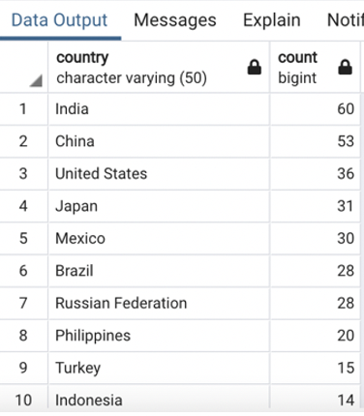
10 Top Countries were Rockbuster has more customers
These are the top 10 countries were Rockbuster has the biggest number of customers.
Ckick here to open the map in Tableu Public Link

Slide 4
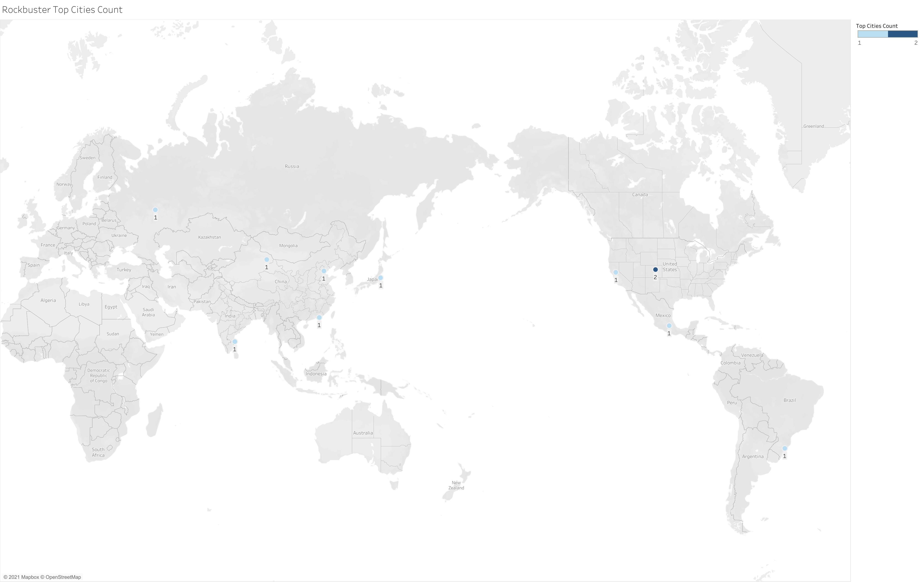
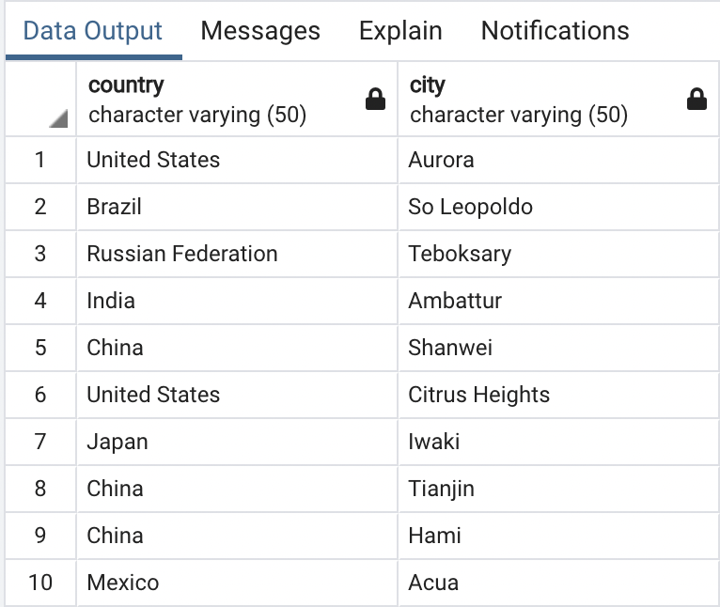
10 Top Cities were Rockbuster has more customers
Click here to open the map in Tableau Public
These are the top 10 cities withing the 10 top countries were Rockbuster has the highest number of customers.

Slide 5

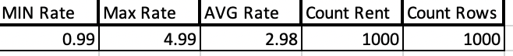
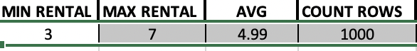
Rockbuster’s RENTAL Numbers
RENTAL RATE
RENTAL DURATION

Slide 6
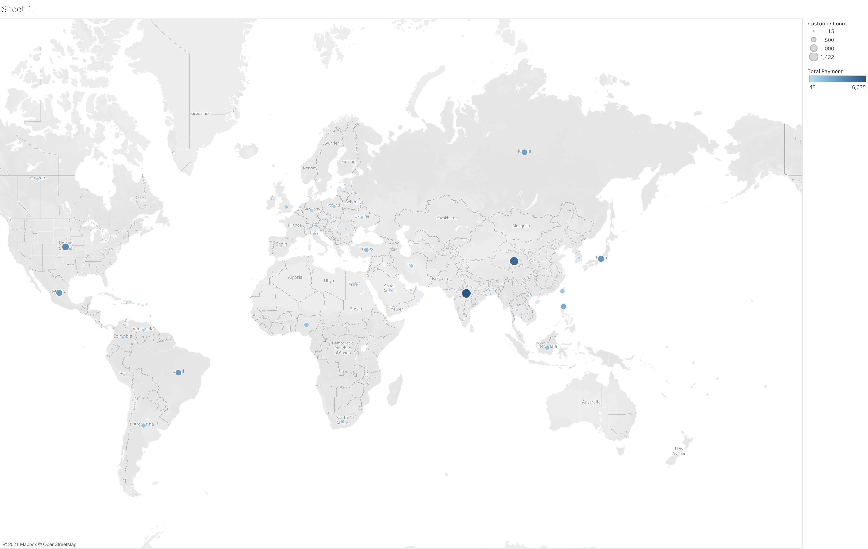
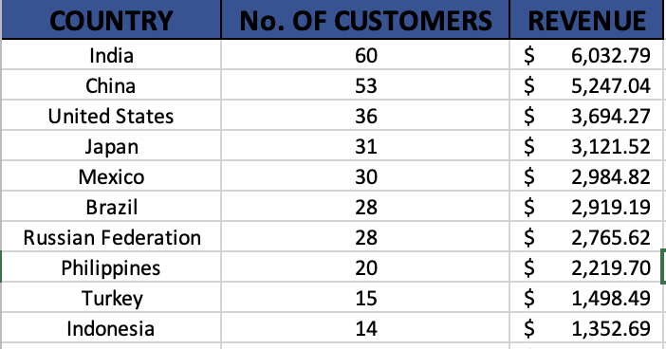
10 Top Countries Revenue
Click here to open the map in Tableau Public

Slide 7
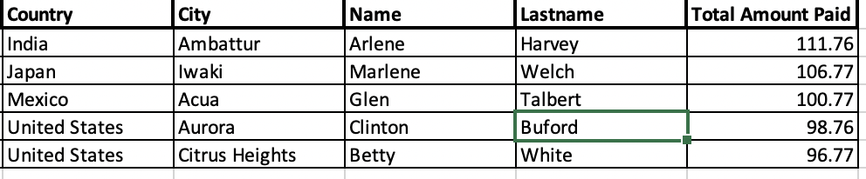


Rockbuster’s Top 5 Customers

